Slide 1
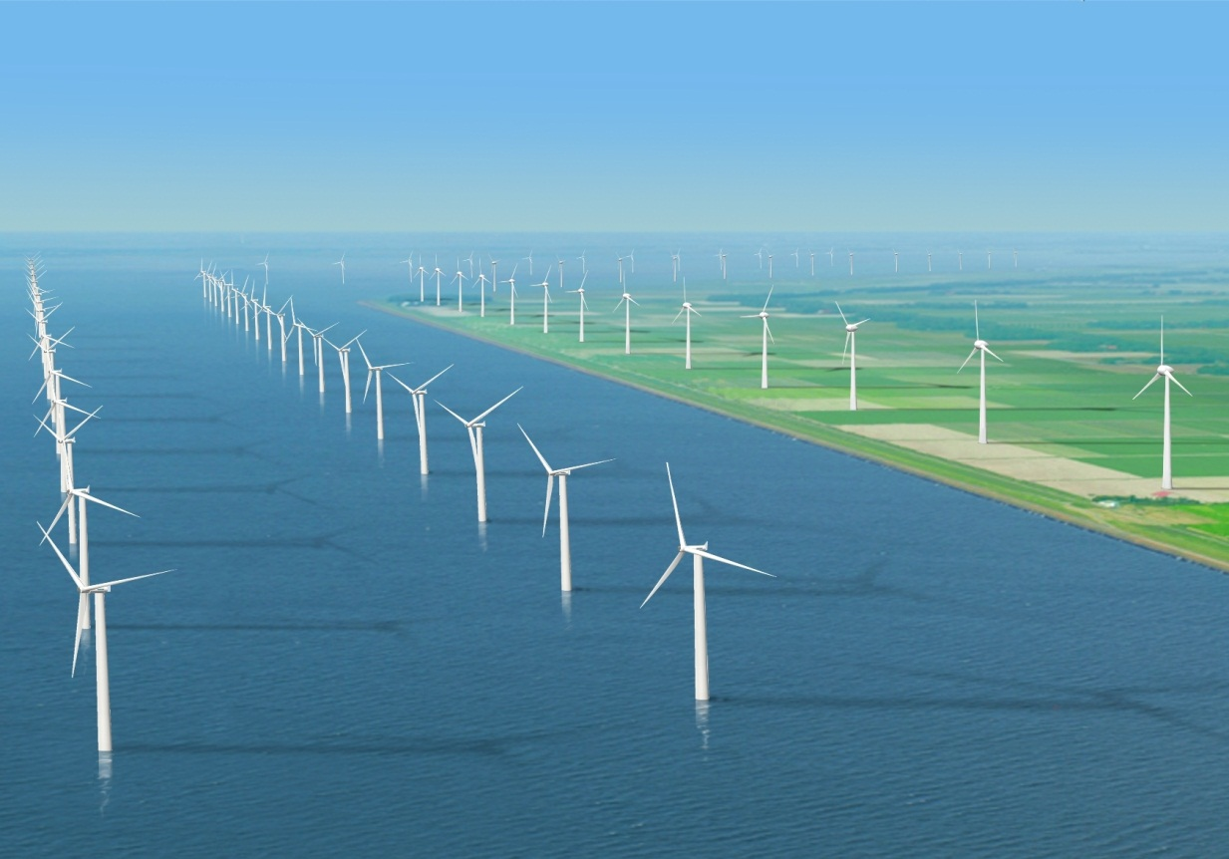
WIND FARMS

Slide 2
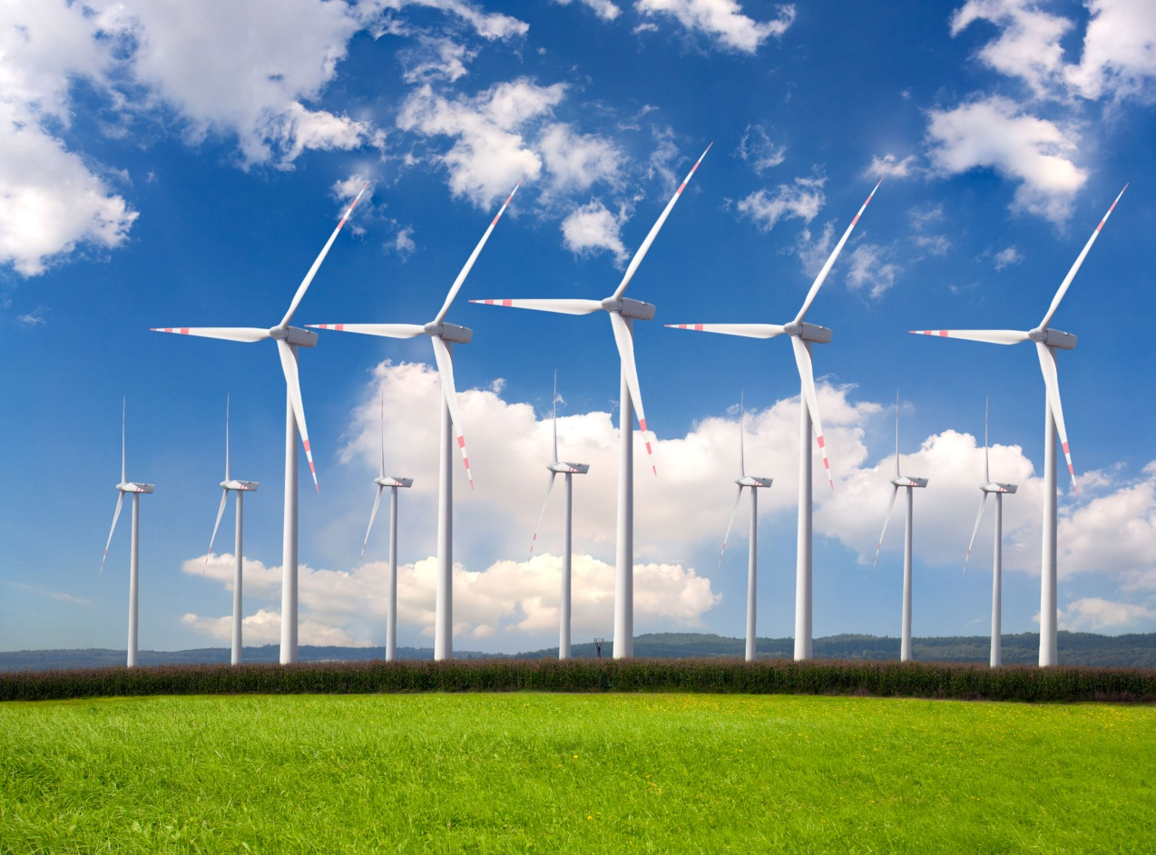
A wind farm or wind park is a group of wind turbines in the same location used to produce electricity. A large wind farm may consist of several hundred individual wind turbines and cover an extended area of hundreds of square miles, but the land between the turbines may be used for agricultural or other purposes .

Slide 3
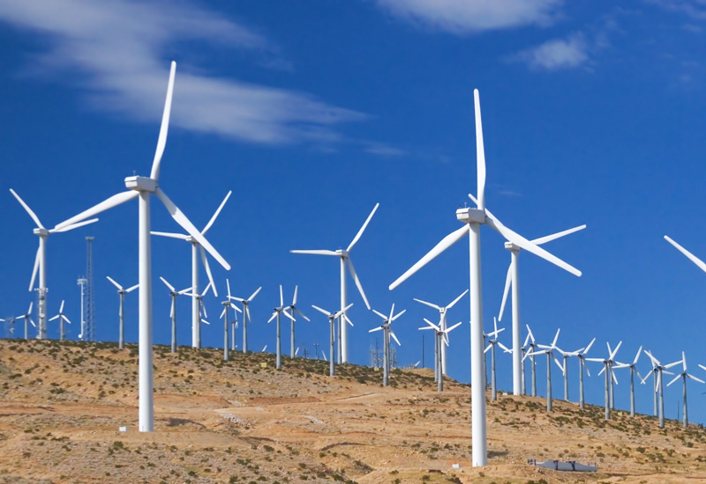
Many of the largest operational onshore wind farms are located in China and the United States. For example, the largest wind farm in the world, Gansu Wind Farm in China has a capacity of over 6,000 MW of power in 2012 with a goal of 20,000 MW by 2020. The Alta Wind Energy Center in California, United States is the largest onshore wind farm outside of China, with a capacity of 1,020 MW.As of April 2013, the 630 MW London Array in the UK is the largest offshore wind farm in the world, followed by the 504 MW Greater Gabbard wind farm in the UK.

Slide 4
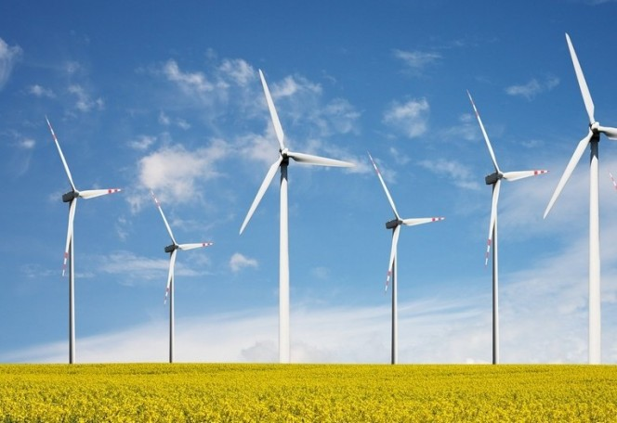
A wind turbine is the popular name for a device that converts kinetic energy from the wind into electrical power. Technically there is no turbine used in the design but the term appears to have migrated from parallel hydroelectric technology. The correct description for this type of machine would be aerofoil -powered generator. A wind turbine used for charging batteries may be referred to as a wind charger.

Slide 5
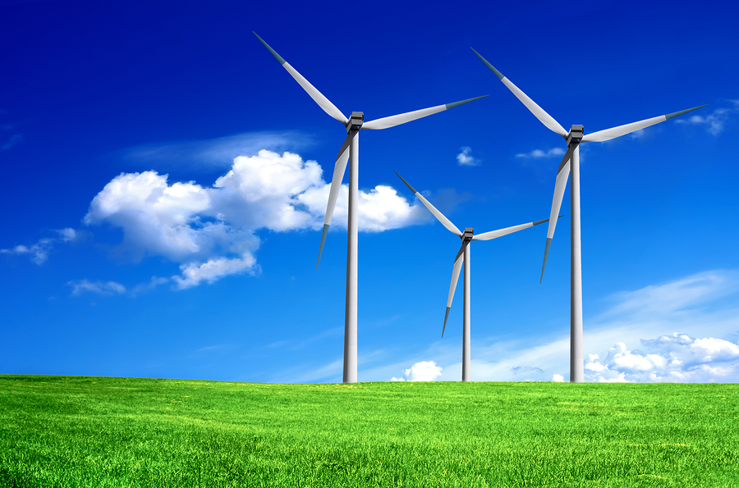
The first electricity-generating wind turbine was a battery charging machine installed in July 1887 by Scottish academic James Blythto light his holiday home in Marykirk, Scotland. Some months later American inventor Charles F. Brush built the first automatically operated wind turbine for electricity production in Cleveland, Ohio. Although Blyth's turbine was considered uneconomical in the United Kingdom electricity generation by wind turbines was more cost effective in countries with widely scattered populations.

Slide 6
THE END
Authors of the material
Gohar Hovhannisyan
Eprikyan Shushan
Meghedi Degirmenjyan
Mijin.mskh.am

